Slide 1
Edu-Tech
We aspire to teach !!

Slide 2
OVERVIEW
01
TECH-STACK
02
TABLE OF CONTENTS
WORK-FLOW
03
04
PROTOTYPE
05
FEATURES
06
FUTURE ADD-ONS

Slide 3
OVERVIEW
We have developed an android app on domain “Education”. Our app primarily focuses on minimizing distractions and helping students to have an organized environment for learning. We have added features like activity tracker so that students can have a checklist of tasks and they can track how much progress they have made in that particular activity. This app also reminds students to complete their activities. We provide study resources which can be accessed and shared within peers to enhance their skill-set.

Slide 4

TECH-STACK
JAVA
XML
FIREBASE

Slide 5
WORK-FLOW
Wire framing the UI/UX
Add backend to the app
Will do the research about similar working prototypes which are in the market
We will design the user interface
Connect to the firebase

Slide 6
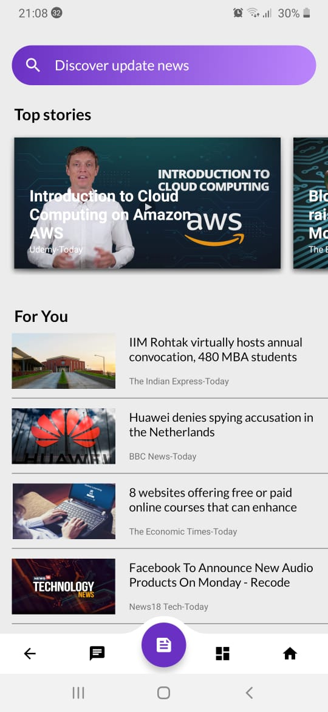
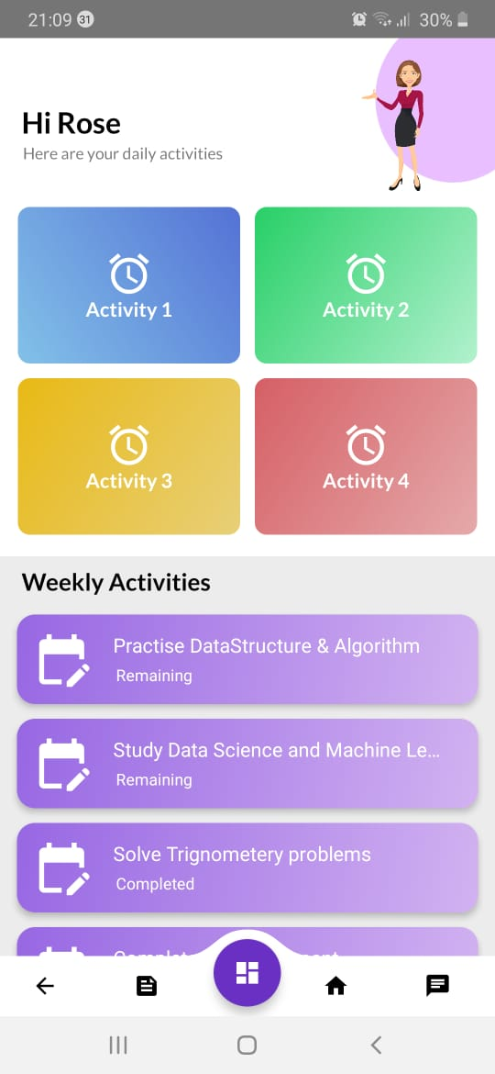
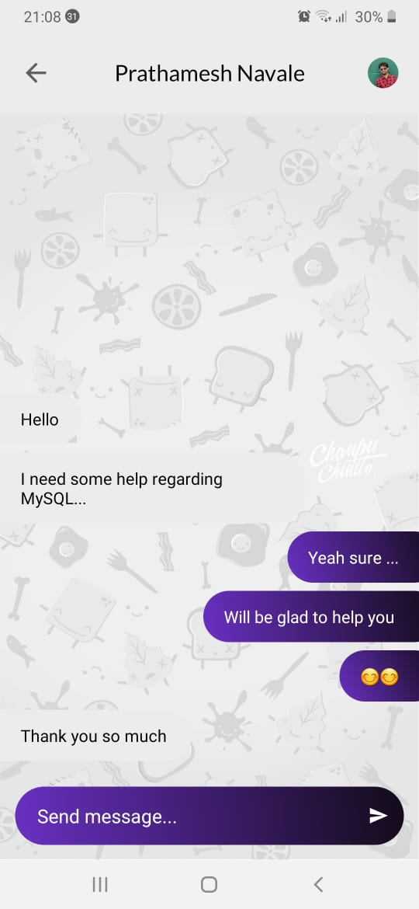
PROTOTYPE

Slide 7
FEATURES
News
Forums
Activities
Edu-Tech App
Communication
QUIZ
Graph

Slide 8
FUTURE ADD-ONS
Team Activity
Contest
Forums
Users can create teams and distribute their task.This can help to work as a team.
Users can test their knowledge by attempting various contests in a fun way.
User can join different forums and can share their ideas on the topic

Slide 9
THANK
YOU !

